Slide 1
SIT313 Developing client server web apps Project 2
Group 20
Sachin avishka de silva - 215326393
Dilina perera - 216260121
Sameera dinusha - 215158268

Slide 2
App description
Weather application which allows user to check weather for a given location.
User can enter the city name and weather forecast will be shown on the screen.
Detailed weather forecast for upcoming days.

Slide 3
App features
Weather forecast
Rain forecast
Cross platform
Database feature
Multi-Screen
Interfaces
APIs
Synchronisation
Customizable settings
Search feature for a city

Slide 4
Outcome of the project
Throughout this project our group were able to develop a cross platform application through visual studio using Xamarin.Forms. We gained many valuable skills to develop an app like this throughout the unit and now we have a clear understanding about how to operate Xamarin. And also what we learnt during the practical classes were really helpful throughout the process of the project. Furthermore the lecturers and tutors help were also immense in this. Midway through the project, we got into a major setback. Our API which we retrieve data stopped working. Somehow with the help of tutors and online resources, we fixed it and able to finish this on a high note. There are still some features which we like to implement and develop this application to a more professional piece of work.

Slide 5
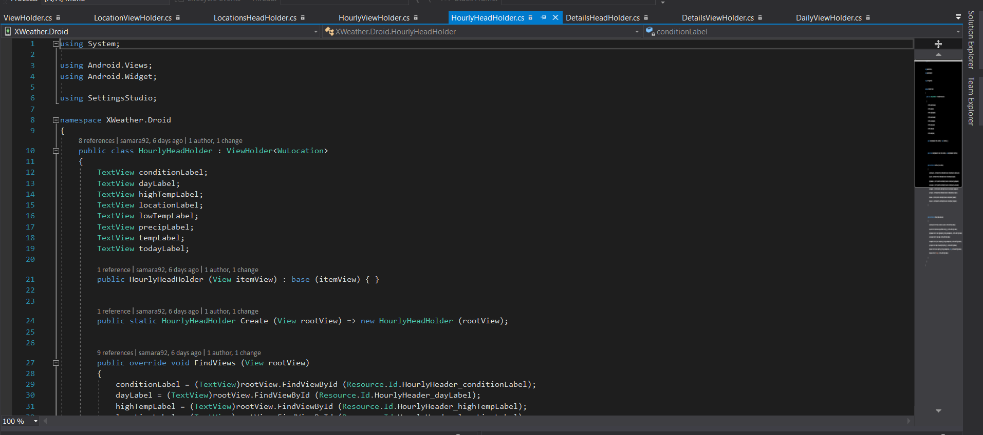
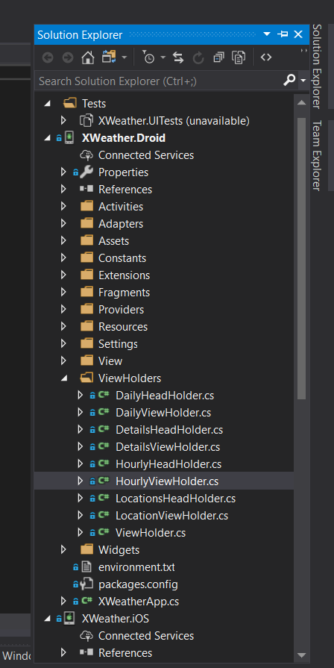
Screenshots

Slide 6
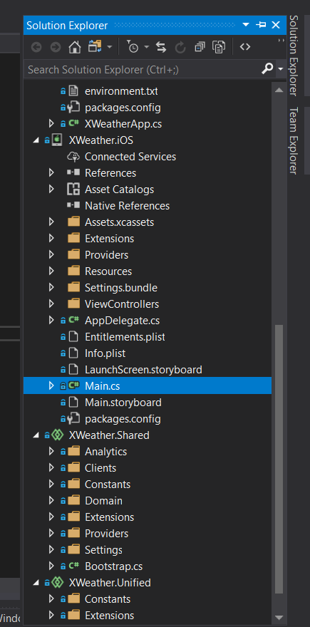
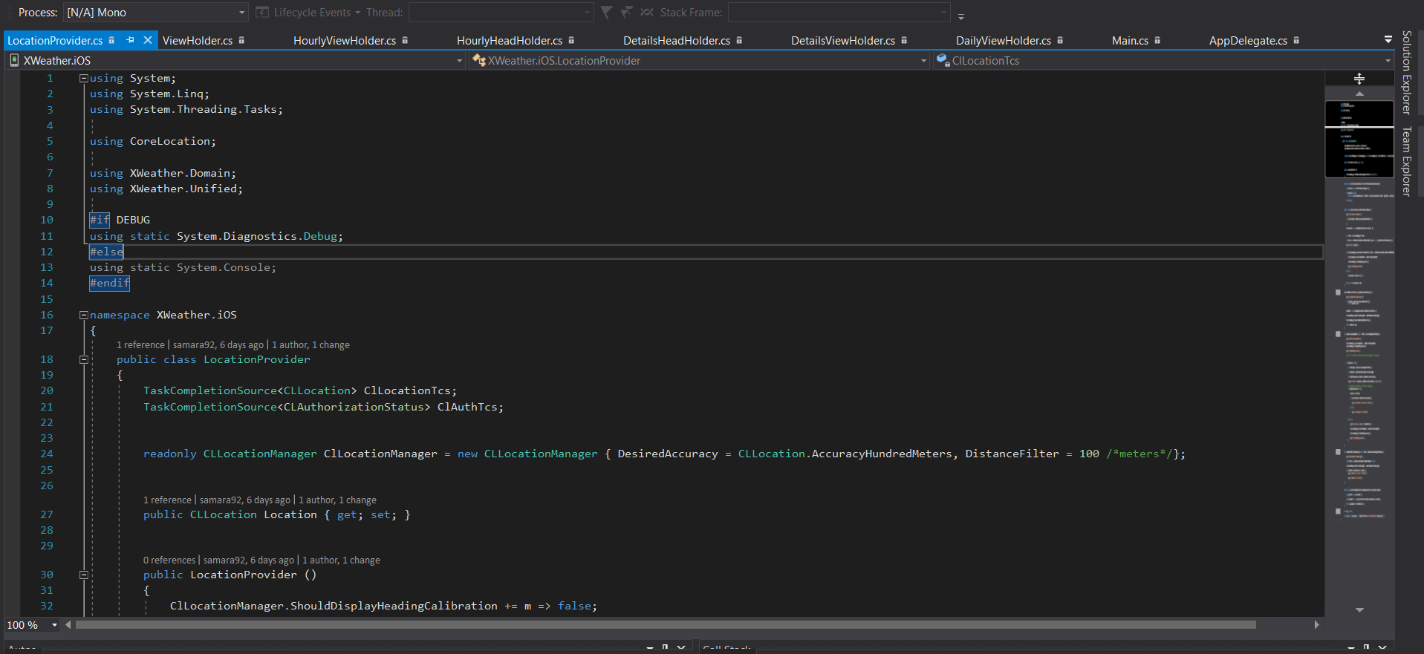
Screenshots contd.

Slide 7
Project timeline
Week 6 – Designing UI
Week 7 – Finishing up UI and start basic coding.
Week 8 – Start implementing features (API, Interfaces, Database feature etc.)
Week 9 – Finishing touches and debugging.

Slide 8
Links
GitHub link – https://github.com/Avieeee/Weather-app.git
Trello link - https://trello.com/sit3136
YouTube link - https://youtu.be/sZOF9W5LGfY

Slide 9
Contributions
Dilina Perera – iOS and research regarding the app features.
Sameera Dinusha – iOS and user interface (Mock-ups, designing etc.)
Sachin Avishka de Silva – Android app and Weekly updates and submissions. (Trello, GitHub).

